Slide 1
Automatic Speech Recognition
Ying shen
School of software engineering
Tongji university

Slide 2
Outline
Introduction
Speech recognition based on HMM
Acoustic processing
Acoustic modeling: Hidden Markov Model
Language modeling
Statistical approach
Speech recognition based on DBN
Deep belief network

Slide 3
What is speech recognition?
Automatic speech recognition(ASR) is the process by which a computer maps an acoustic speech signal to text.
Challenges for researchers
Linguistic factor
Physiologic factor
Environmental factor

Slide 4
Classification of speech recognition system
Users
Speaker dependent system
Speaker independent system
Speaker adaptive system
Vocabulary
small vocabulary : tens of word
medium vocabulary : hundreds of words
large vocabulary : thousands of words
very-large vocabulary : tens of thousands of words
Word pattern
isolated-word system : single words at a time
continuous speech system : words are connected together

Slide 5
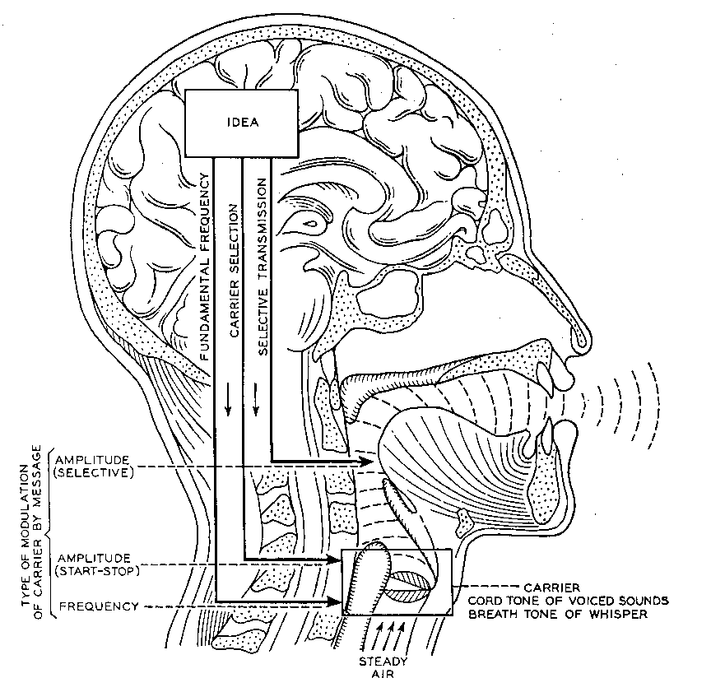
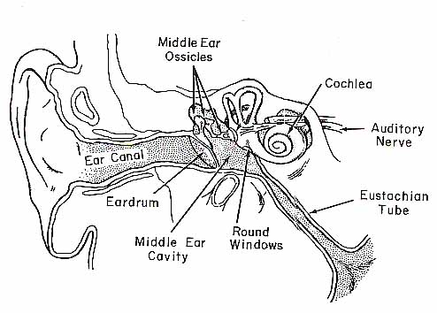
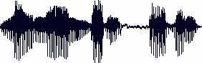
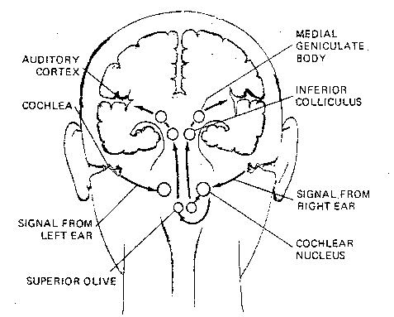
How do human do it?
Articulation produces sound waves
Which the ear conveys to the brain
for processing

Slide 6
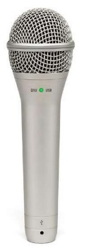
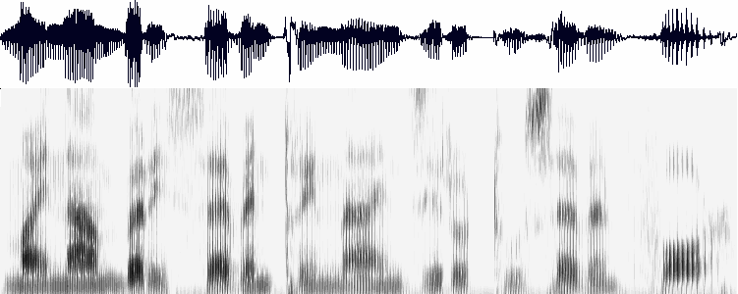
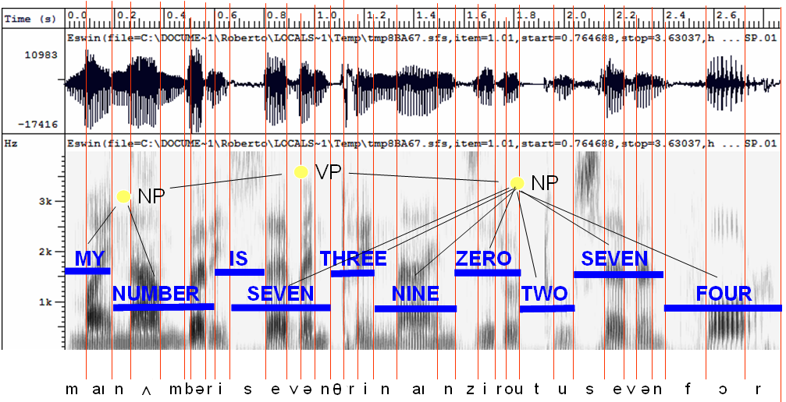
How might computers do it?
Digitization
Acoustic analysis of the speech signal
Linguistic interpretation
Acoustic waveform
Acoustic signal
Speech recognition

Slide 7
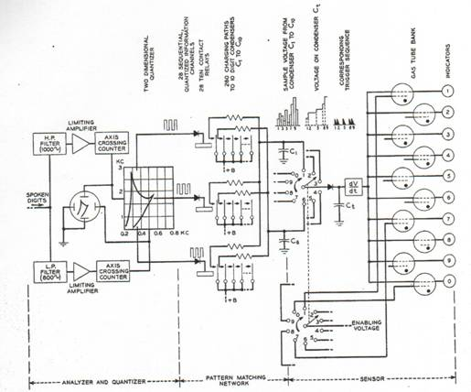
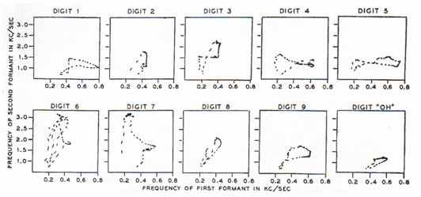
History of ASR
1952 – Automatic Digit Recognition (AUDREY)
Davis, Biddulph, Balashek (Bell Laboratories)
Notes:
The first serious speech recognizer was developed in 1952 by Davis, Biddulph, and Balashek of Bell Labs. Analog circuit using filters, amplifiers and integrators. Using a simple frequency splitter, it generated plots of the first two formants, which it identified by matching them against prestored patterns in an analog memory. With training, it was reported, the machine achieved 97 percent accuracy on the spoken forms of ten digits.
Thus an utterance of an unknown digit could be recognized if its pattern on the formant-one/formant-two plane was compared with those of all digits plotted during the experimental phase. That was the principle on which Audrey was based. Rather than comparing the whole patterns point by point, twenty numbers were computed and stored for each digit, characterizing the corresponding average pattern on the formant-one/formant-two plane. Those twenty characteristic numbers were then computed, in the same way, for any incoming utterance to be recognized, and compared with the stored sets. The digit with the stored set of twenty numbers more similar to the newly computed one was the digit that most probably was uttered. Speaker dependent.
(wiki) In 1952 three Bell Labs researchers built a system for single-speaker digit recognition. Their system worked by locating the formants in the power spectrum of each utterance.^{[7]} The 1950s era technology was limited to single-speaker systems with vocabularies of around ten words.

Slide 8
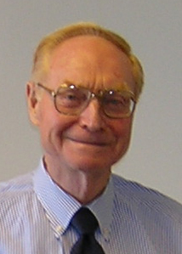
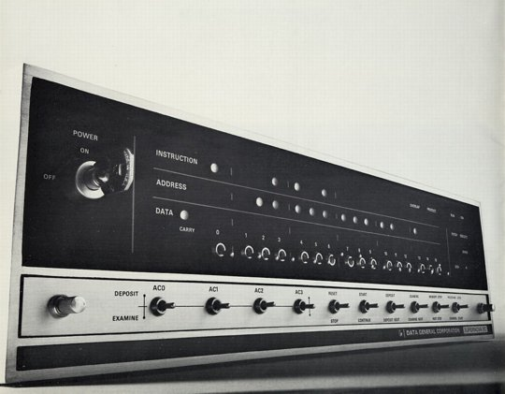
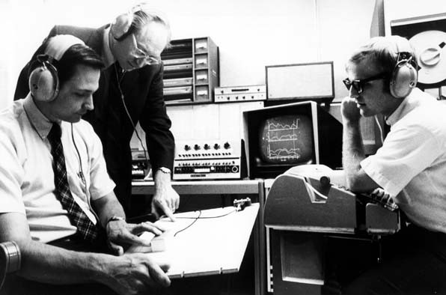
History of ASR
1960’s – Speech Processing and Digital Computers
AD/DA converters and digital computers start appearing in the labs
James Flanagan
Bell Laboratories
Notes:
Flanagan joined Bell Labs in 1957. Although there was already some work done in speech processing it was mostly using analog circuits. Jim helped to introduce AD/DA and start pioneering new research in speech processing using computers. Much easier, more flexible and cheaper than building electric circuits. Much larger experiments possible altho not in real time for quite a while.

Slide 9
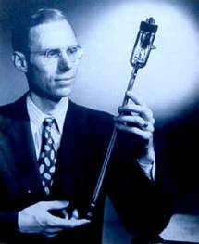
History of ASR
1969 – Whither Speech Recognition?
General purpose speech recognition seems far away. Social-purpose speech recognition is severely limited. It would seem appropriate for people to ask themselves why they are working in the field and what they can expect to accomplish…
It would be too simple to say that work in speech recognition is carried out simply because one can get money for it. That is a necessary but not sufficient condition. We are safe in asserting that speech recognition is attractive to money. The attraction is perhaps similar to the attraction of schemes for turning water into gasoline, extracting gold from the sea, curing cancer, or going to the moon. One doesn’t attract thoughtlessly given dollars by means of schemes for cutting the cost of soap by 10%. To sell suckers, one uses deceit and offers glamour…
Most recognizers behave, not like scientists, but like mad inventors or untrustworthy engineers. The typical recognizer gets it into his head that he can solve “the problem.” The basis for this is either individual inspiration (the “mad inventor” source of knowledge) or acceptance of untested rules, schemes, or information (the untrustworthy engineer approach).
The Journal of the Acoustical Society of America, June 1969
J. R. Pierce
Executive Director,
Bell Laboratories
Notes:
(wiki) Unfortunately, funding at Bell Labs dried up for several years when, in 1969, the influential John Pierce wrote an open letter that was critical of speech recognition research.^{[8]} Pierce defunded speech recognition research at Bell Labs where no research on speech recognition was done until Pierce retired and James L. Flanagan took over.
Every technology has its own negative people. Never believed. He was right that he never saw good performance.

Slide 10
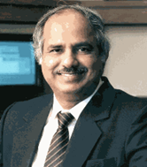
History of ASR
1971-1976: The ARPA SUR project
Despite anti-speech recognition campaign led by Pierce Commission ARPA launches 5 year Spoken Understanding Research program
Goal: 1000-word vocabulary, 90% understanding rate, near real time on 100 mips machine
4 Systems built by the end of the program
SDC (24%)
BBN’s HWIM (44%)
CMU’s Hearsay II (74%)
CMU’s HARPY (95% -- but 80 times real time!)
Rule-based systems except for Harpy
Engineering approach: search network of all the possible utterances
Raj Reddy -- CMU
Notes:
the objective of ASR is, properly, speech understanding, not simply correct identification of words in a spoken message. Systems, therefore, should be evaluated in terms of their ability to respond correctly to spoken messages about such pragmatic problems as travel budget management. Limited domain, somewhat speaker tuned, quiet room. The objective goal of ARPA SUR was a recognition system with 90 percent sentence accuracy for continuous-speech sentences, using thousand-word vocabularies, not in real time. Of four principal ARPA SUR projects, the only one to meet the stated goal was Carnegie Mellon University's Harpy system, which achieved a 5 percent error rate on a 1,011-word vocabulary on continuous speech. One of the ways the CMU team achieved the goal was clever: they made the task easier by restricting word order; that is, by limiting spoken words to certain sequences in the sentence.
(wiki) Raj Reddy was the first person to take on continuous speech recognition as a graduate student at Stanford University in the late 1960s. Previous systems required the users to make a pause after each word. Reddy's system was designed to issue spoken commands for the game of chess.

Slide 11
History of ASR
1971-1976: The ARPA SUR project
Lack of clear evaluation criteria
ARPA felt systems had failed
Project not extended
Speech Understanding: too early for its time
Need a standard evaluation method

Slide 12
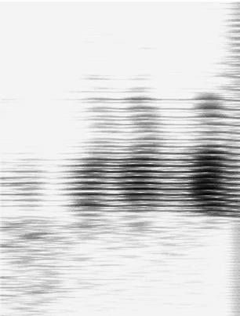
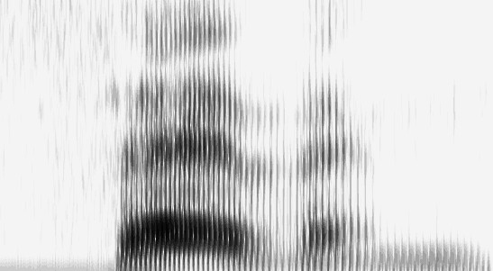
History of ASR
1970’s – Dynamic Time Warping
The Brute Force of the Engineering Approach
T.K. Vyntsyuk (1968)
H. Sakoe,
S. Chiba (1970)
TEMPLATE (WORD 7)
Isolated Words
Speaker Dependent
Connected Words
Speaker Independent
Sub-Word Units
UNKNOWN WORD
Notes:
Compare input to word templates. What features discriminate between one word and another? Spectrograms? Divided into frames? With avg intensity computed over that frame. Word is seven.
Compute the least cost path of best matches of feature vectors between unknown word and templates, using dynamic programming. Recognizing one word could take seconds to hours, depending on vocabulary size and word length. Isolated word recognition.
(wiki) Also around this time Soviet researchers invented the dynamic time warping (DTW) algorithm and used it to create a recognizer capable of operating on a 200-word vocabulary.^{[9]} The DTW algorithm processed the speech signal by dividing it into short frames, e.g. 10ms segments, and processing each frame as a single unit. Although DTW would be superseded by later algorithms, the technique of dividing the signal into frames would carry on. Achieving speaker independence was a major unsolved goal of researchers during this time period.

Slide 13
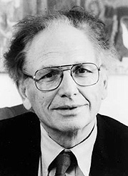
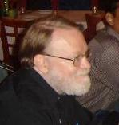
History of ASR
1980s -- The Statistical Approach
Based on work on Hidden Markov Models done by Leonard Baum at IDA, Princeton in the late 1960s
Purely statistical approach pursued by Fred Jelinek and Jim Baker, IBM T.J.Watson Research
Foundations of modern speech recognition engines
Fred Jelinek
Acoustic HMMs
Word Tri-grams
a11
a22
a33
Jim Baker
a12
a23
S1
S2
S3
Notes:
Harpy represented all possible sentences as a finite state machine with 15K nodes of acoustic templates. Problem of finding best path thru network much like finding best path comparing word templates. Again, dynamic programming. IBM added probabilities to the mix, estimating statistical models of phonemes automatically from data. Performance went from 35% with hand-estimated models to 75%.

Slide 14
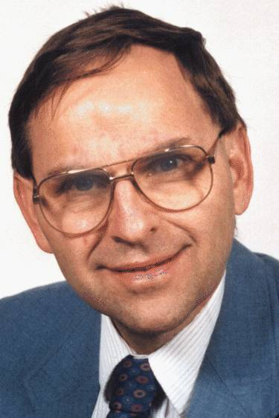
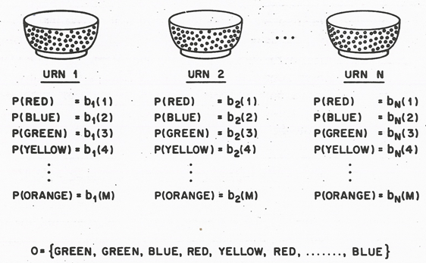
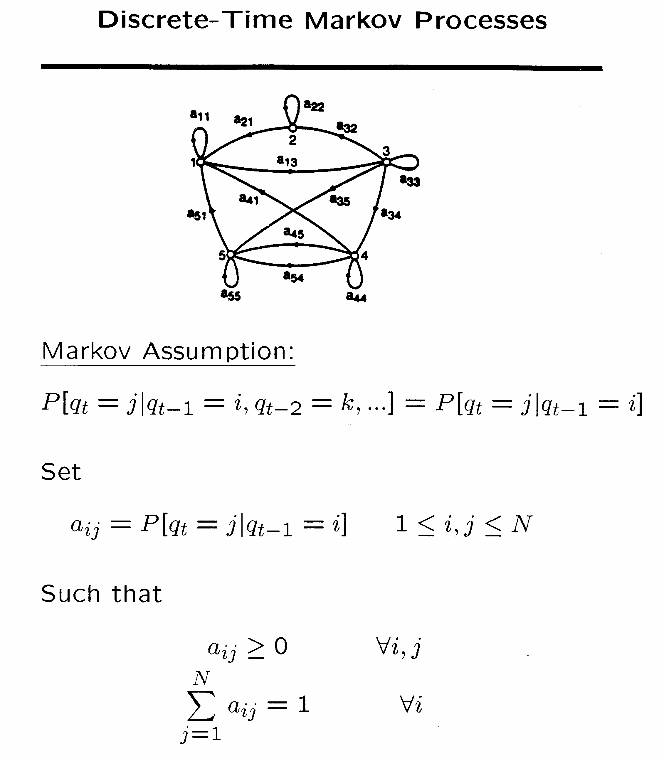
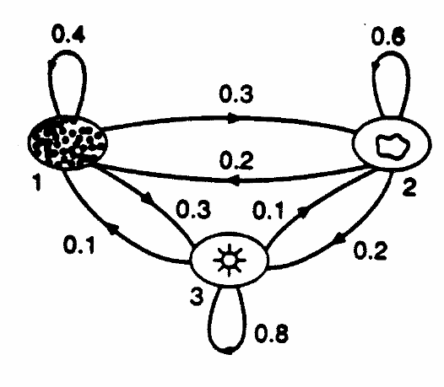
History of ASR
1980-1990 – Statistical approach becomes ubiquitous
Lawrence Rabiner, A Tutorial on Hidden Markov Models and Selected Applications in Speech Recognition, Proceeding of the IEEE, Vol. 77, No. 2, February 1989.
Notes:
HMMs represent sequential constraints of language. Actual processes of the vocal tract in producing a particular phone are ‘hidden states’ – but we can observe their result in the acoustic signal.
从Baum提出相关数学推理，经过Labiner等人的研究，李开复最终实现了第一个基于隐马尔科夫模型的大词汇量语音识别系统Sphinx，他也凭借此发明获得1988 美国商业周刊最重要发明奖。此后严格来说语音识别技术并没有脱离HMM框架，可以说现在手机上的语音拨号就脱胎于李开复的语音识别系统。

Slide 15
History of ASR: 21st Century
Low noise conditions
Large vocabulary
~20,000-60,000 words or more…
Speaker independent (vs. speaker-dependent)
Continuous speech (vs isolated-word)
Multilingual, conversational
World’s best research systems:
Human-human speech: 5.5% Word Error Rate (WER)
Human-machine or monologue speech: ~3-5% WER
Notes:
In the early 2000s, speech recognition was still dominated by traditional approaches such as Hidden Markov Models combined with feedforward artificial neural networks.^{[29]} Today, however, many aspects of speech recognition have been taken over by a deep learning method called Long short-term memory (LSTM), a recurrent neural network published by Sepp Hochreiter & Jürgen Schmidhuber in 1997.^{[30]} LSTM RNNs avoid the vanishing gradient problem and can learn "Very Deep Learning" tasks^{[31]} that require memories of events that happened thousands of discrete time steps ago, which is important for speech. Around 2007, LSTM trained by Connectionist Temporal Classification (CTC)^{[32]} started to outperform traditional speech recognition in certain applications.^{[33]} In 2015, Google's speech recognition reportedly experienced a dramatic performance jump of 49% through CTC-trained LSTM, which is now available through Google Voice to all smartphone users.^{[34]}
The use of deep feedforward (non-recurrent) networks for acoustic modeling was introduced during later part of 2009 by Geoffrey Hinton and his students at University of Toronto and by Li Deng and colleagues at Microsoft Research, initially in the collaborative work between Microsoft and University of Toronto which was subsequently expanded to include IBM and Google (hence "The shared views of four research groups" subtitle in their 2012 review paper).^{[35][36][37]} A Microsoft research executive called this innovation "the most dramatic change in accuracy since 1979."^{[38]} In contrast to the steady incremental improvements of the past few decades, the application of deep learning decreased word error rate by 30%. This innovation was quickly adopted across the field. Researchers have begun to use deep learning techniques for language modeling as well.

Slide 16
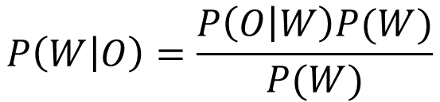
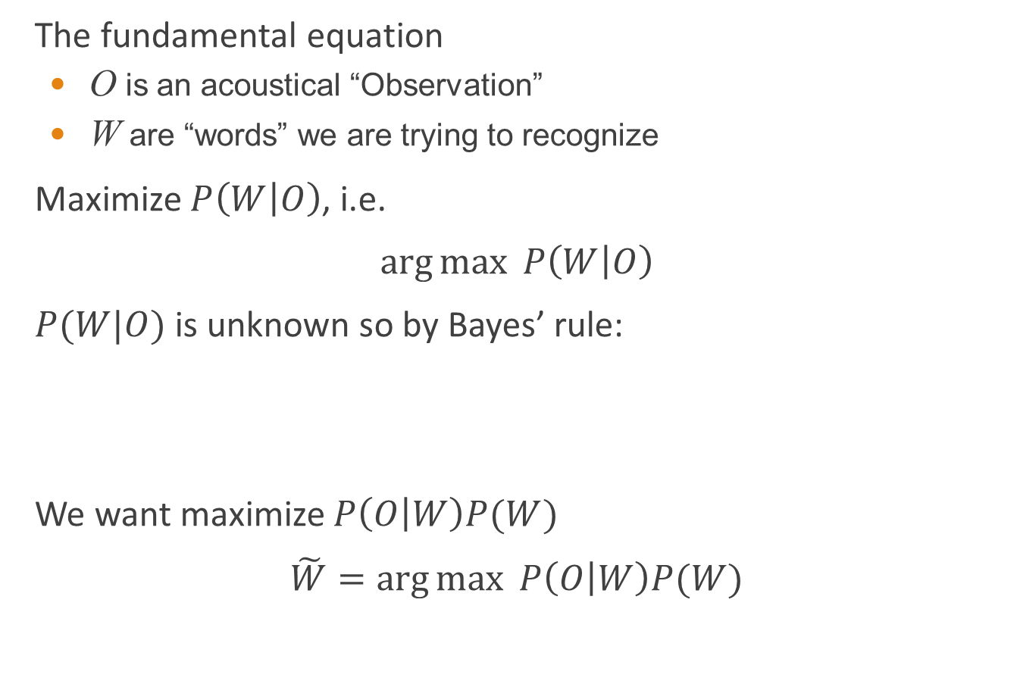
Architecture of an ASR system
The fundamental equation
O is an acoustical “Observation”
W are “words” we are trying to recognize
Maximize $P\left(W | O\right)$, i.e.
$\arg{\max{ P\left(W | O\right)}⁡ }$
$P(W|O)$is unknown so by Bayes’ rule:
We want maximize $P\left(O | W\right)P(W)$
$\tilde{W}=\arg{\max{ P\left(O | W\right)P(W)}⁡ }$
$$P\left(W | O\right)=\frac{P\left(O | W\right)P(W)}{P(W)}$$
constant value
Determined by a set of acoustic model
Determined by a language model

Slide 17
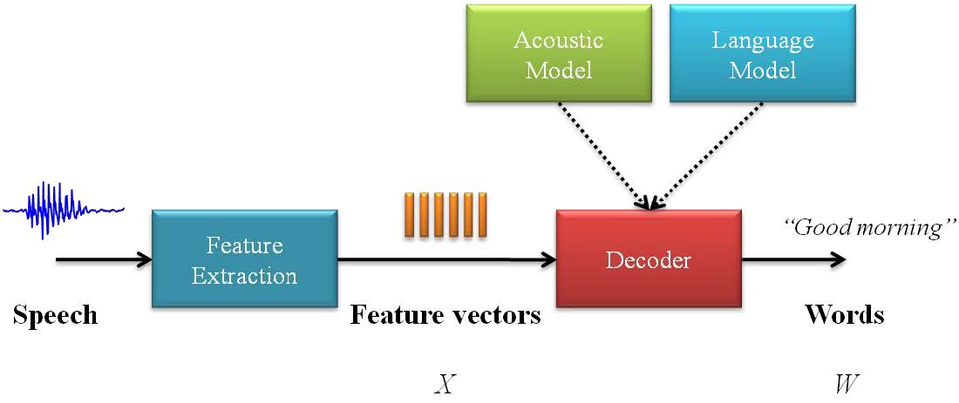
Architecture of an ASR system

Slide 18
Statistical Speech recognition model

Slide 19
Statistical Speech recognition model
Word sequence is postulated and the language model computes its probability.
Each word is converted into sounds or phones using pronunciation dictionary.
Each phoneme has a corresponding statistical Hidden Markov Model (HMM).
HMM of each phoneme is concatenated to form word model and the likelihood of the data given the word sequence is computed.
This process is repeated for many word sequences and the best is chosen as the output.

Slide 20
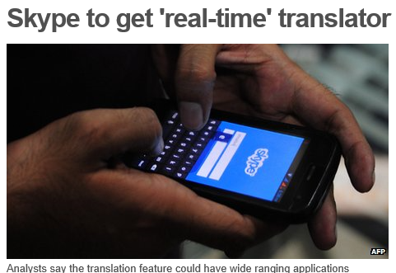

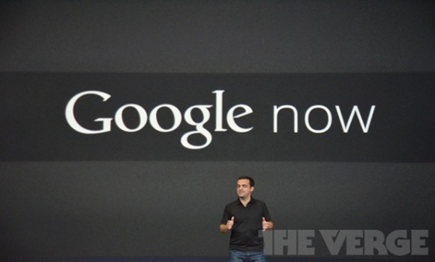

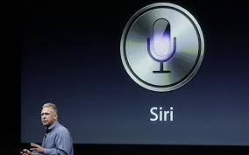
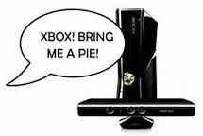

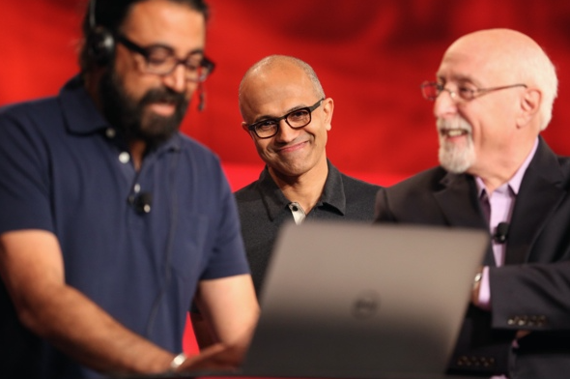
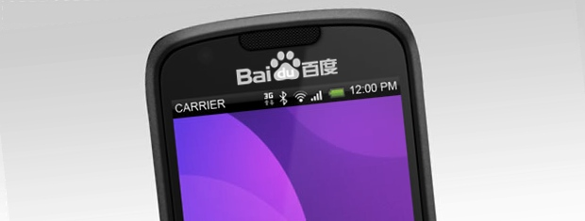
Applications of ASR
Cortana
Notes:
Google now
Siri
S-Voice
Dragon Search
Dragon Dictation
Trippo-Mondo
Verbally

Slide 21
Outline
Introduction
Speech recognition based on HMM
Acoustic processing
Acoustic modeling: Hidden Markov Model
Language modeling
Statistical approach
Speech recognition based on DBN
Deep belief network

Slide 22
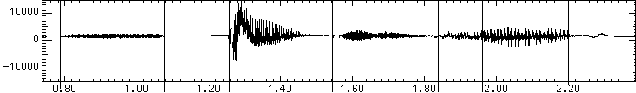
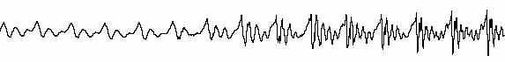
Acoustic processing
A wave for the words “speech lab” looks like:
s p ee ch l a b
“l” to “a”
transition:
Graphs from Simon Arnfield’s web tutorial on speech, Sheffield:
http://lethe.leeds.ac.uk/research/cogn/speech/tutorial/

Slide 23
Acoustic sampling
10 ms frame (ms = millisecond = 1/1000 second)
~25 ms window around frame to smooth signal processing
25 ms
. . .
10ms
Result:
Acoustic Feature Vectors
a₁ a₂ a₃

Slide 24
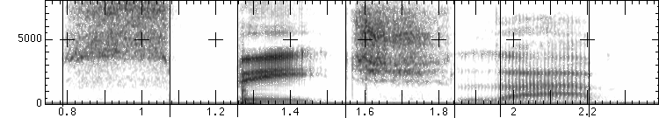
Spectral analysis
Frequency gives pitch; amplitude gives volume
sampling at ~8 kHz phone, ~16 kHz mic (kHz=1000 cycles/sec)
Fourier transform of wave yields a spectrogram
darkness indicates energy at each frequency
hundreds to thousands of frequency samples
s p ee ch l a b
amplitude
frequency
Notes:
那我们为什么要在声谱图中表示语音呢？
首先，音素（Phones）的属性可以更好的在这里面观察出来。另外，通过观察共振峰和它们的转变可以更好的识别声音。隐马尔科夫模型（Hidden Markov Models）就是隐含地对声谱图进行建模以达到好的识别性能。还有一个作用就是它可以直观的评估TTS系统（text to speech）的好坏，直接对比合成的语音和自然的语音声谱图的匹配度即可。
http://blog.csdn.net/zouxy09/article/details/9156785

Slide 25
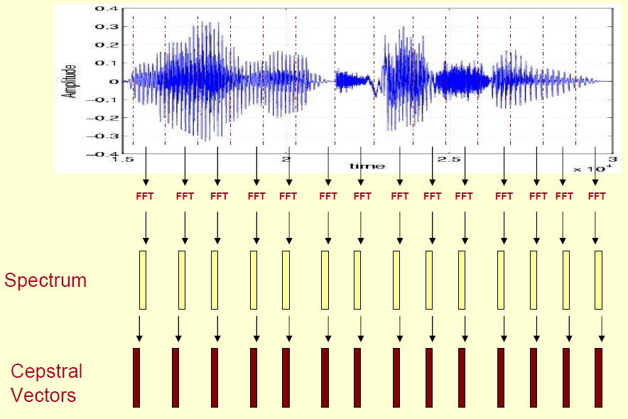
Mel-frequency cepstrum coefficients
MFCC are mostly used features in state-of-art speech recognition system
Notes:
http://www.speech.cs.cmu.edu/15-492/slides/03_mfcc.pdf

Slide 26
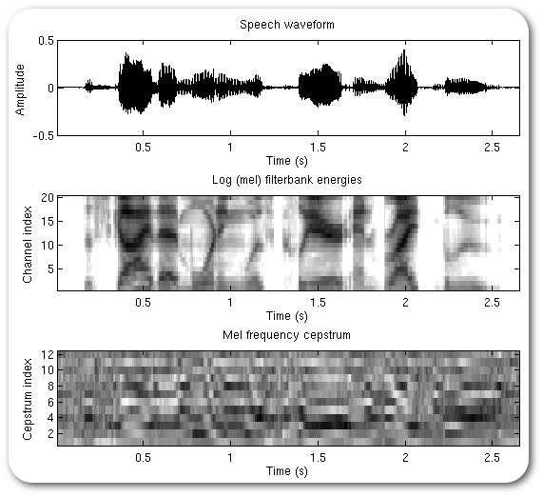
Mel-frequency cepstrum coefficients

Slide 27
Outline
Introduction
Speech recognition based on HMM
Acoustic processing
Acoustic modeling: Hidden Markov Model
Language modeling
Statistical approach
Speech recognition based on DBN
Deep belief network

Slide 28
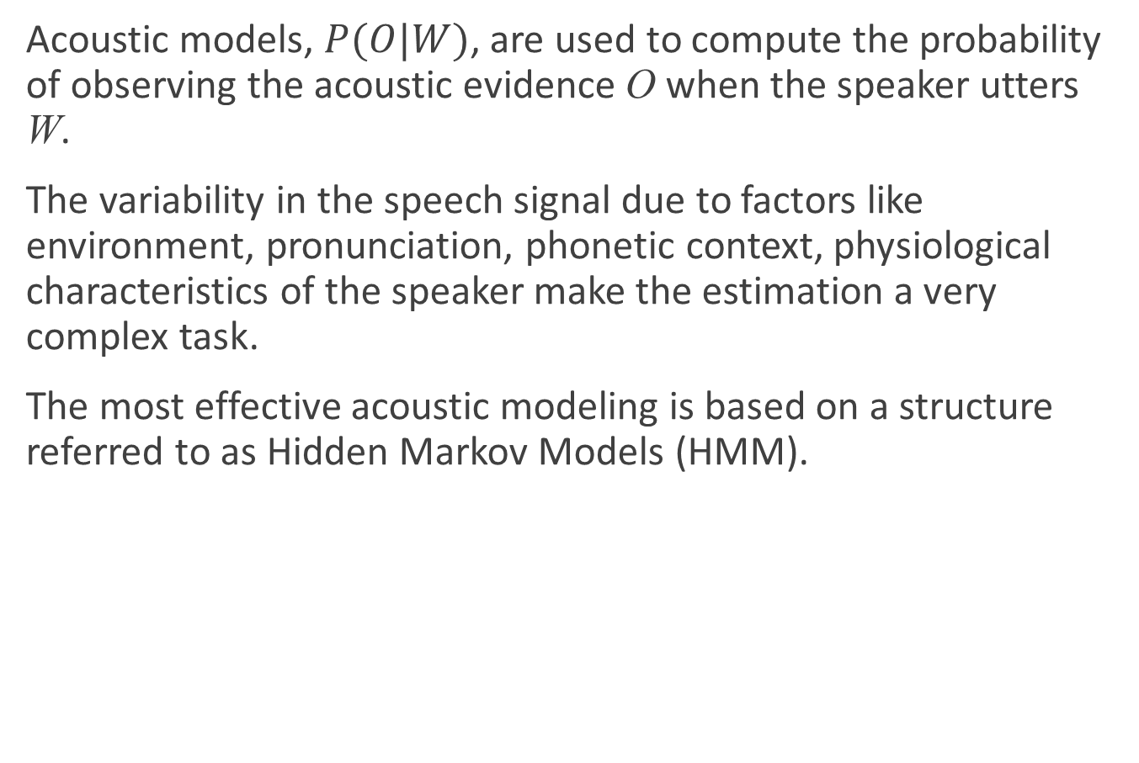
Acoustic modeling: Hidden Markov Model
Acoustic models, $P(O|W)$, are used to compute the probability of observing the acoustic evidence O when the speaker utters W.
The variability in the speech signal due to factors like environment, pronunciation, phonetic context, physiological characteristics of the speaker make the estimation a very complex task.
The most effective acoustic modeling is based on a structure referred to as Hidden Markov Models (HMM).

Slide 29
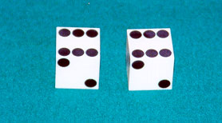
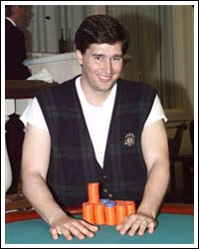
HMM
Example: The dishonest casino
A casino has two dice:
Fair die
P(1) = P(2) = P(3) = P(4) = P(5) = P(6) = 1/6
Loaded die
P(1) = P(2) = P(3) = P(4) = P(5) = 1/10
P(6) = 1/2
Casino player switches between fair and loaded die with probability 1/20 at each turn

Slide 30
HMM
Game
You bet $1
You roll (always with a fair die)
Casino player rolls (maybe with fair die, maybe with loaded die)
Highest number wins $2

Slide 31
Question # 1 – Decoding
GIVEN
A sequence of rolls by the casino player
QUESTION
What portion of the sequence was generated with the fair die, and what portion with the loaded die?
This is the DECODING question in HMMs
1245526462146146136136661664661636616366163616515615115146123562344
FAIR
LOADED
FAIR

Slide 32
Question # 2 – Evaluation
GIVEN
A sequence of rolls by the casino player
QUESTION
How likely is this sequence, given our model of how the casino works?
This is the EVALUATION problem in HMMs
1245526462146146136136661664661636616366163616515615115146123562344
Prob = 1.3 x 10⁻³⁵

Slide 33
Question # 3 – Learning
GIVEN
A sequence of rolls by the casino player
QUESTION
How “loaded” is the loaded die? How “fair” is the fair die? How often does the casino player change from fair to loaded, and back?
This is the LEARNING question in HMMs
1245526462146146136136661664661636616366163616515615115146123562344
Prob(6) = 64%

Slide 34
The dishonest casino model
0.05
0.95
0.95
FAIR
LOADED
0.05
P(1|F) = 1/6
P(2|F) = 1/6
P(3|F) = 1/6
P(4|F) = 1/6
P(5|F) = 1/6
P(6|F) = 1/6
P(1|L) = 1/10
P(2|L) = 1/10
P(3|L) = 1/10
P(4|L) = 1/10
P(5|L) = 1/10
P(6|L) = 1/2

Slide 35
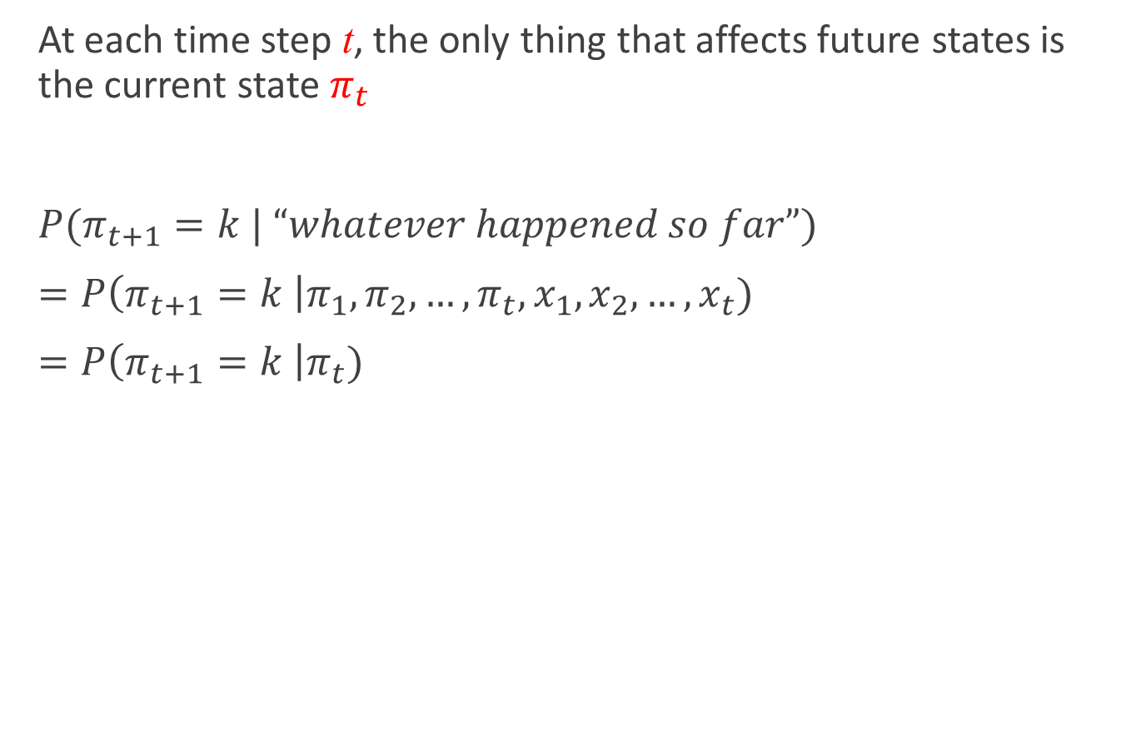
An HMM is memoryless
At each time step t, the only thing that affects future states is the current state $π_{t}$
$P(π_{t+1}=k | “whatever happened so far”)$
$=P\left(π_{t+1}=k \right|π_{1}, π_{2},…,π_{t},x_{1}, x_{2}, …, x_{t})$
$=P\left(π_{t+1}=k \right|π_{t})$
1
2
K
…

Slide 36
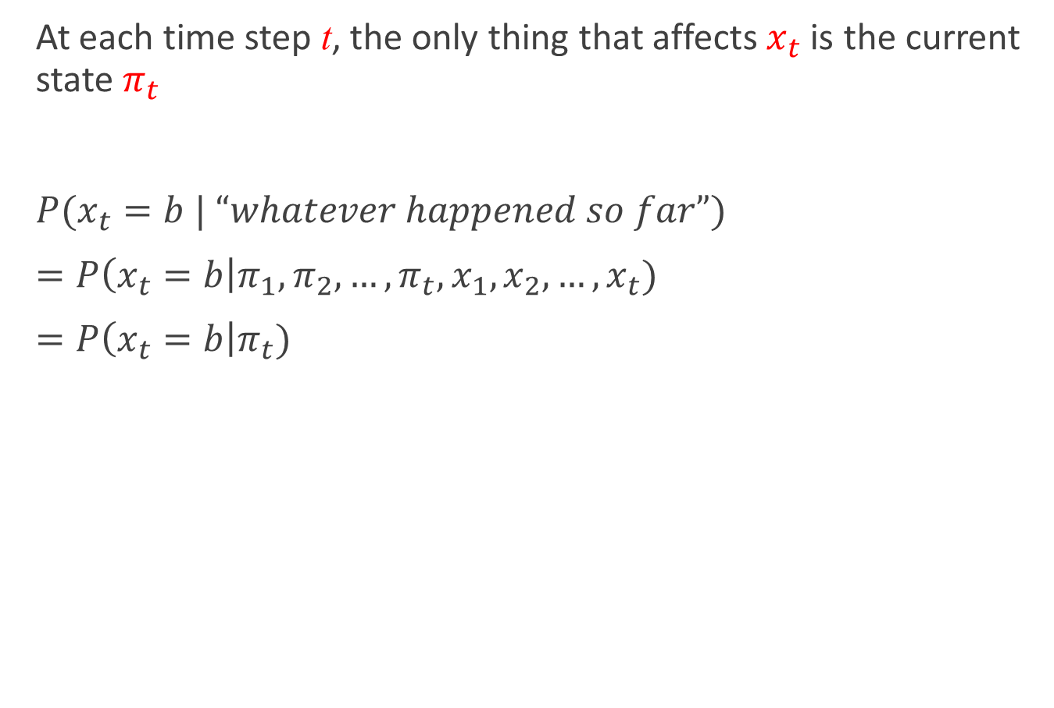
An HMM is memoryless
At each time step t, the only thing that affects $x_{t}$ is the current state $π_{t}$
$P(x_{t}=b | “whatever happened so far”)$
$=P\left(x_{t}=b\right|π_{1}, π_{2},…,π_{t},x_{1}, x_{2}, …, x_{t})$
$=P\left(x_{t}=b\right|π_{t})$
1
2
K
…

Slide 37
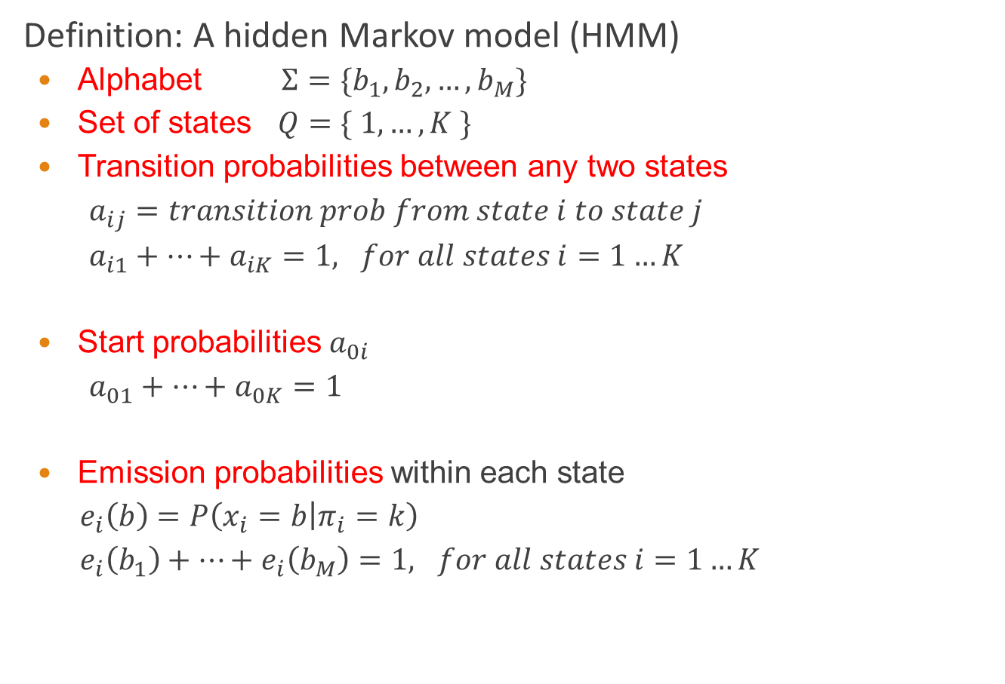
Definition of HMM
Definition: A hidden Markov model (HMM)
Alphabet $Σ=\{b_{1}, b_{2}, …, b_{M}\}$
Set of states $Q=\{ 1, …, K \}$
Transition probabilities between any two states
$a_{ij}=transition prob from state i to state j$
$a_{i1}+…+a_{iK}=1, for all states i=1…K$
Start probabilities $a_{0i}$
$a_{01}+…+a_{0K}=1$
Emission probabilities within each state
$e_{i}\left(b\right)=P\left(x_{i}=b | π_{i}=k\right)$
$e_{i}\left(b_{1}\right)+…+e_{i}\left(b_{M}\right)=1, for all states i=1…K$
1
2
K
…

Slide 38
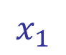
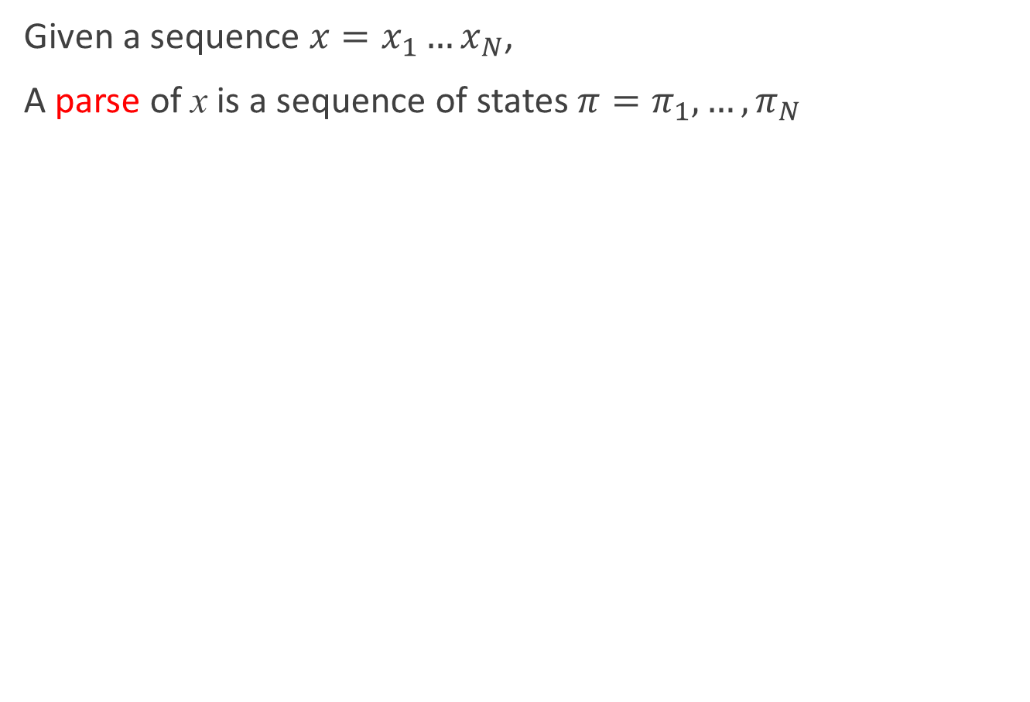
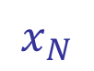
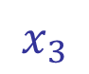
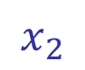
A parse of a sequence
Given a sequence $x=x_{1}…x_{N}$,
A parse of x is a sequence of states $π=π_{1},…,π_{N}$
1
1
1
1
…
1
2
2
2
2
2
…
2
…
…
…
…
K
K
K
K
…
K
$$x_{1}$$
$$x_{2}$$
$$x_{3}$$
$$x_{N}$$

Slide 39
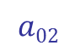
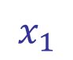
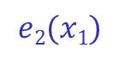




Generating a sequence by the model
Given a HMM, we can generate a sequence of length N as follows:
Start at state $π_{1}$ according to prob $a_{0π_{1}}$
Emit letter $x_{1}$ according to prob $e_{π_{1}}(x_{1})$
Go to state $π_{2}$ according to prob $a_{π_{1}π_{2}}$
… until emitting $x_{N}$
1
1
1
1
…
1
$$a02$$
2
2
2
2
2
…
2
0
…
…
…
…
K
K
K
K
…
K
$$e2(x1)$$
$$x_{1}$$
$$x_{2}$$
$$x_{3}$$
$$x_{N}$$

Slide 40






Likelihood of a parse
Given a sequence $x=x_{1}…x_{N}$ and a parse $π=π_{1},…π_{N}$,
To find how likely this scenario is: (given our HMM)
1
1
1
1
…
1
2
2
2
2
2
…
2
…
…
…
…
K
K
K
K
K
…
$$x_{1}$$
$$x_{2}$$
$$x_{3}$$
$$x_{N}$$
$$P\left(x, π\right)= P\left(x_{1}, …, x_{N}, π_{1}, …, π_{N}\right)=P\left(x_{N} | π_{N}\right)P\left(π_{N} | π_{N}−1\right)…P\left(x_{2} | π_{2}\right)P\left(π_{2} | π_{1}\right)P\left(x_{1} | π_{1}\right)P\left(π_{1}\right)$$
$$=a_{0π_{1}} a_{π_{1}π_{2}}…a_{π_{N−1}π_{N}}e_{π_{1}}(x_{1})…e_{π_{N}}(x_{N})$$

Slide 41


Example: the dishonest casino
Let the sequence of rolls be:
$x=1, 2, 1, 5, 6, 2, 1, 5, 2, 4$
Then, what is the likelihood of
$π=Fair, Fair, Fair, Fair, Fair, Fair, Fair, Fair, Fair, Fair$?
(say initial probs $a_{0Fair}=½, a_{0Loaded}=½$)
So, the likelihood the die is fair in this run is just $0.521×{10}^{−9}$
$$\frac{1}{2}×P\left(1 | Fair\right)P\left(Fair | Fair\right)P\left(2 | Fair\right)P\left(Fair | Fair\right)…P\left(4 | Fair\right)=\frac{1}{2}×{\left(\frac{1}{6}\right)}^{10}×{\left(0.95\right)}^{9}=.00000000521158647211≈0.5∗{10}^{−9}$$

Slide 42


Example: the dishonest casino
What is the likelihood of
$π=Loaded, Loaded, Loaded, Loaded, Loaded, Loaded,$
$Loaded, Loaded, Loaded, Loaded$?
Therefore, it’s somewhat more likely that all the rolls are done with the fair die, than that they are all done with the loaded die
$$\frac{1}{2}×P\left(1 | Loaded\right)P\left(Loaded, Loaded\right)…P\left(4 | Loaded\right)$$
$$=\frac{1}{2}×{\left(\frac{1}{10}\right)}^{9}×\left(\frac{1}{2}\right)×{\left(0.95\right)}^{9}=.00000000015756235243≈.16×{10}^{−9}$$

Slide 43



Example: the dishonest casino
Let the sequence of rolls be:
$x=1, 6, 6, 5, 6, 2, 6, 6, 3, 6$
Now, what is the likelihood $π=F, F, …, F$?
, same as before
What is the likelihood $π=L, L, …, L$?
So, it is 100 times more likely the die is loaded
$$\frac{1}{2}×{\left(\frac{1}{6}\right)}^{10}×{\left(0.95\right)}^{9}≈0.5×{10}^{−9}$$
$$\frac{1}{2}×{\left(\frac{1}{10}\right)}^{4}×{\left(\frac{1}{2}\right)}^{6}×{\left(0.95\right)}^{9}=.00000049238235134735$$
$$≈0.5×{10}^{−7}$$

Slide 44

The three main questions on HMMs
Decoding
GIVEN a HMM $M$, and a sequence $x$,
FIND the sequence $π$ of states that maximizes $P[x, π|M]$
Evaluation
GIVEN a HMM $M$, and a sequence $x$,
FIND $Prob[x|M]$
Learning
GIVEN a HMM $M$, with unspecified transition/emission probs., and a sequence $x$,
FIND parameters $θ=(e_{i}(.), a_{ij})$that maximize $P[x|θ]$

Slide 45
Another example: Teacher-mood-model
The observation is a probabilistic function of the state.
Situation:
Your school teacher gave three different types of daily homework assignments:
A: took about 5 minutes to complete
B: took about 1 hour to complete
C: took about 3 hours to complete
Your teacher did not reveal openly his mood to you daily, but you knew that your teacher was either in a bad, neutral, or a good mood for a whole day.
Mood changes occurred only overnight.
Question How were his moods related to the homework type assigned that day?

Slide 46


Another example: Teacher-mood-model
Model parameters:
Alphabet $Σ=\{A, B,C\}$
Set of states
$$Q=\{ good, neutral, bad\}$$
Transition probabilities between any two states $a_{ij}$
Emission probabilities within each state $e_{i}\left(x\right)$

Slide 47

Another example: Teacher-mood-model
One week, your teacher gave the following homework assignments:
Questions
What did his mood curve look like most likely that week?
Searching for the most probable path – Viterbi algorithm
What is the probability that he would assign this order of homework assignments?
Probability of a sequence - Forward algorithm
How do we adjust the model parameters $λ\left(Q,a_{ij},e_{i}\left(x\right)\right)$to maximize $P(π| M)$
create a HMM for a given sequence set
Monday | Tuesday | Wednesday | Thursday | Friday
A | C | B | A | C

Slide 48


HMM: Viterbi algorithm
Given
Hidden Markov model: $Q, a_{ij} ,Σ ,e_{i}\left(x\right)$
Observed symbol sequence $π=x_{1}x_{2}…x_{n}$.
Most probable path of states that resulted in symbol sequence $π$.
Let $v_{i}\left(k\right)$ be the probability of the most probable path of the symbol sequence $x_{1},x_{2},…,x_{k}$ ending in state $i$. Then:
$$v_{l}\left(k+1\right)=\max_{i}{(e_{l}\left(x_{k+1}\right)∗v_{i}\left(k\right)∗a_{il})}$$
$$=e_{l}\left(x_{k+1}\right)∗\max_{i}\left(v_{i}\left(k\right)∗a_{il}\right)$$

Slide 49



HMM: Viterbi algorithm
Matrix $v_{i}(k)$, where $k∈Q$ and $1≤l≤ n$.
Initialization: for all states $k∈Q$ .
$v_{l}\left(k\right)=e_{l}\left(x_{i}\right)\max_{i}{(v_{i}\left(k − 1\right)a_{il}})$for all states $k∈Q,i≥2$.
Algorithm
$$v_{1}\left(k\right)=\frac{e_{i}\left(x_{1}\right)}{\#states}$$
Iteratively build up matrix $v_{i}(k)$.
Store pointers to chosen path.
Probability of most probable path in maximum entry in last column.
Reconstruct path along pointers.

Slide 50

HMM: Viterbi algorithm
Empty table

Slide 51


HMM: Viterbi algorithm
Initialization:
$$v_{l}\left(1\right)=\frac{e_{l}\left(A\right)}{\#states}$$

Slide 52


HMM: Viterbi algorithm
$v_{l}\left(2\right)=e_{l}\left(C\right)\max_{i}{(v_{i}\left(1\right)a_{il})}$

Slide 53


HMM: Viterbi algorithm
$v_{l}\left(3\right)=e_{l}\left(B\right)\max_{i}{(v_{i}\left(2\right)a_{il})}$

Slide 54

HMM: Viterbi algorithm
Maximum entry in last column

Slide 55

HMM: Viterbi algorithm
Reconstruct path along pointers

Slide 56
HMM: Viterbi algorithm
Question
What did his mood curve look like most likely that week?
Answer
Most probable mood curve:
Day | Monday | Tuesday | Wednesday | Thursday | Friday
Assignment | A | C | B | A | C
Mood | good | bad | neutral | good | bad

Slide 57

HMM: Parameter estimation
Question
How do we know the transition probabilities $a_{ij}$ and the emission probabilities $e_{i}(x)$?
Answer
We use training sequences and construct maximum likelihood estimators.

Slide 58



HMM: Parameter estimation
Case 1 State sequences of training sequences are known
We construct Maximum Likelihood estimators.
Let $A_{ij}$ be the number of transitions from state i to j in training data ( + constant)
Let $E_{i}(x)$ be the number of emissions of symbol x from state i in training data ( + constant)
Transition estimator:
Emission estimator:
$$a_{ij}=\frac{A_{ij}}{\sum_{j^{′}}{A_{ij^{′}}}}$$
$$e_{i}\left(x\right)=\frac{E_{i}\left(x\right)}{\sum_{x^{′}}{E_{i}\left(x^{′}\right)}}$$

Slide 59

HMM: Parameter estimation
Case 2 State sequences of training sequences are not known
Viterbi training We iteratively use the Viterbi algorithm to compute the most probable paths and set the parameters (from case 1) according to this data
Algorithm sketch:
Initialization: Pick arbitrary model parameters
Repeat
Set all $A_{ij}$ and $E_{i}\left(x\right)$ to their constant value
For each training sequence
Compute most probable state paths (Viterbi)
Add contribution to $A_{ij}$ and $E_{i}\left(x\right)$
Update $a_{ij}=\frac{A_{ij}}{\sum_{j^{′}}{A_{ij^{′}}}}$ and $e_{i}\left(x\right)=\frac{E_{i}\left(x\right)}{\sum_{x^{′}}{E_{i}\left(x^{′}\right)}}$
Until stopping criterion is reached

Slide 60
HMM in ASR
How HMM can used to classify feature sequences to known classes.
Make a HMM to each class.
By determining the probability of a sequence to the HMMs, we can decide which HMM could most probable generate the sequence.
There are several idea what to model:
Isolated word recognition ( HMM for each known word)
Usable just on small dictionaries. (digit recognition etc.)
Number of states usually >=4. Left-to-right HMM
Monophone acoustic model ( HMM for each phone)
~50 HMM
Triphone acoustic model (HMM for each three phone sequence)
50^3 = 125000 triphones
each triphone has 3 state

Slide 61
HMM in ASR
Hierarchical system of HMMs
HMM of a triphone
HMM of a triphone
HMM of a triphone
Higher level HMM of a word
Language model

Slide 62
Outline
Introduction
Speech recognition based on HMM
Acoustic processing
Acoustic modeling: Hidden Markov Model
Language modeling
Statistical approach
Speech recognition based on DBN
Deep belief network

Slide 63

Language models
Definition probability distribution $Pr⁡(w)$ over sequences of words $w=w_{1}w_{2}…w_{k}$
Critical component of a speech recognition system.
Problems:
Learning: use large text corpus (e.g., several million words) to estimate . Models in this course: n-gram models, maximum entropy models.
Efficiency: computational representation and use

Slide 64


N-Gram models
Definition an n-gram model is a probability distribution based on the nth order Markov assumption
$∀i,\operatorname{Pr}\left(w_{i} | w_{1}…w_{i−1}\right)=\operatorname{Pr}\left(w_{i} | h_{i}\right),\left|h_{i}\right|≤n−1$
Most widely used language models
Consequence by the chain rule,
$$\operatorname{Pr}\left(w\right)=\prod_{i=1}^{k}{Pr⁡(w_{i}|w_{1}…w_{i−1})}=\prod_{i=1}^{k}{Pr⁡(w_{i}|h_{i})}$$

Slide 65



Maximum likelihood
Likelihood Probability of observing sample under distribution $p∈𝒫$, which, given the independence assumption is
Principle Select distribution maximizing sample probability
or
$$\operatorname{Pr}\left(x_{1},…,x_{m}\right)=\prod_{i=1}^{m}{p(x_{i})}$$
$$p^{∗}=\arg{\max_{p∈𝒫}{\prod_{i=1}^{m}{p(x_{i})}}}$$
$$p^{∗}=\arg{\max_{p∈𝒫}{\sum_{i=1}^{m}{\log{p(x_{i})}}}}$$

Slide 66


Example: Bernoulli trials
Problem Find most likely Bernoulli distribution, given sequence of coin flips
H, T, T, H, T, H, T, H, H, H, T, T, . . . , H.
Bernoulli distribution:
$p\left(H\right)=θ,p\left(T\right)=1−θ$
Likelihood
$l\left(p\right)=\log{θ^{\#\left(H\right)}{\left(1−θ\right)}^{\#(T)}}=\#\left(H\right)\log{θ}+\#\left(T\right)\log{(1−θ)}$
Solution l is differentiable and concave;
$$\frac{dl\left(p\right)}{dθ}=\frac{\#(H)}{θ}−\frac{\#(T)}{1−θ}=0⟺θ=\frac{\#(H)}{\#(H)+\#(N)}$$

Slide 67


Maximum Likelihood Estimation
Definitions:
n-gram: sequence of n consecutive words.
S: sample or corpus of size m
$c(w_{1}…w_{k})$: count of sequence $w_{1}…w_{k}$
ML estimates For $c\left(w_{1}…w_{k}\right)≠0$
But, $c\left(w_{1}…w_{k}\right)=0⟹\operatorname{Pr}\left(w_{n} | w_{1}…w_{n−1}\right)=0$!
$$\operatorname{Pr}\left(w_{n} | w_{1}…w_{n−1}\right)=\frac{c(w_{1}…w_{n})}{c(w_{1}…w_{n−1})}$$

Slide 68

N-Gram model problems
Sparsity Assigning probability zero to sequences not
found in the sample $⟹$ speech recognition errors.
Smoothing: adjusting ML estimates to reserve probability mass for unseen events. Central techniques in language modeling.
Class-based models: create models based on classes (e.g., DAY) or phrases.
Representation For $\left|Σ\right|=100,000$, the number of bigrams is ${10}^{10}$, the number of trigrams ${10}^{15}$
Weighted automata: exploiting sparsity.

Slide 69
Smoothing techniques
Typical form: interpolation of n-gram models, e.g., trigram, bigram, unigram frequencies.
Some widely used techniques:
Katz Back-off models (Katz, 1987).
Interpolated models (Jelinek and Mercer, 1980).
Kneser-Ney models (Kneser and Ney, 1995).
$$\operatorname{Pr}\left(w_{3} | w_{1}w_{2}\right)=α_{1}c\left(w_{3} | w_{1}w_{2}\right)+α_{2}c\left(w_{3} | w_{2}\right)+α_{3}c(w_{3})$$

